Slide 1
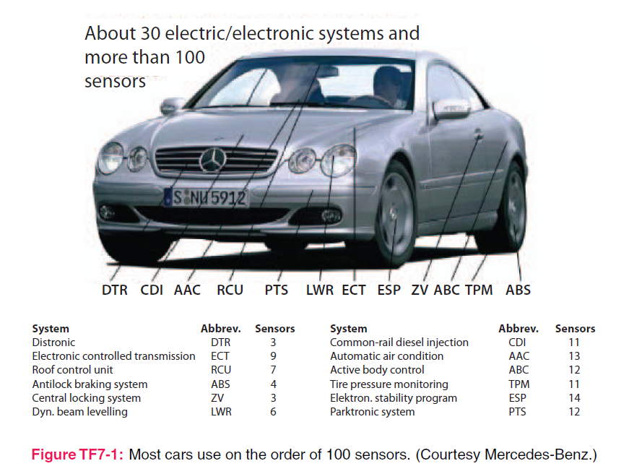
4. Electrostatics
7e Applied EM by Ulaby and Ravaioli

Slide 2
Chapter 4 Overview

Slide 3
Charge, Electric field, Electric potential

Slide 4
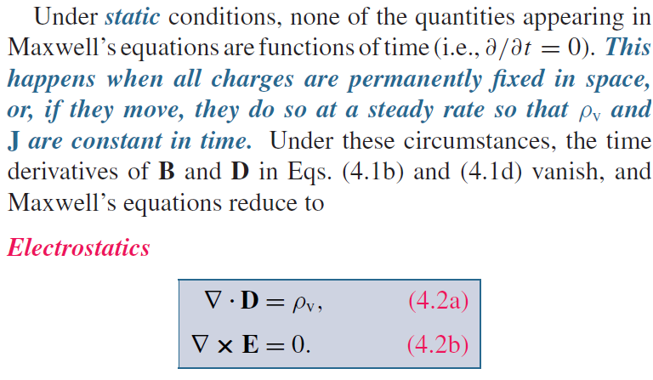
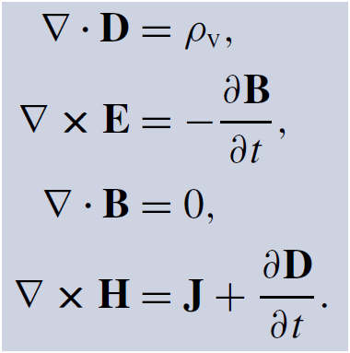
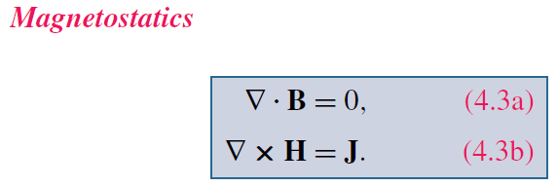
Maxwell’s Equations
God said:
Charge density
Current density
And there was light!

Slide 5
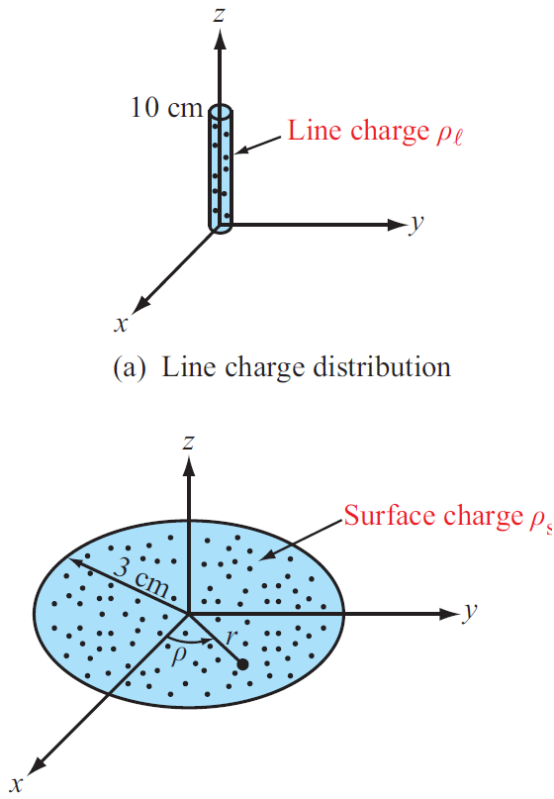
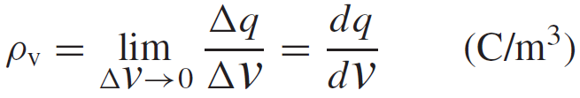
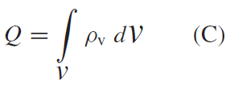
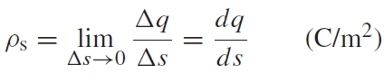
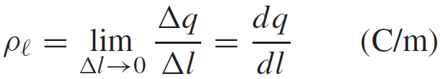
Charge Distributions
Volume charge density:
Total Charge in a Volume
Surface and Line Charge Densities

Slide 6
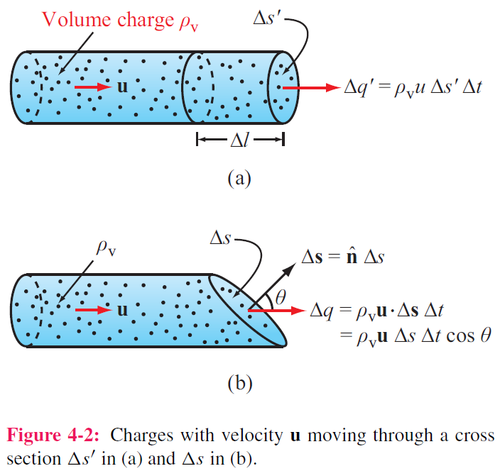
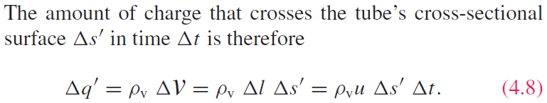
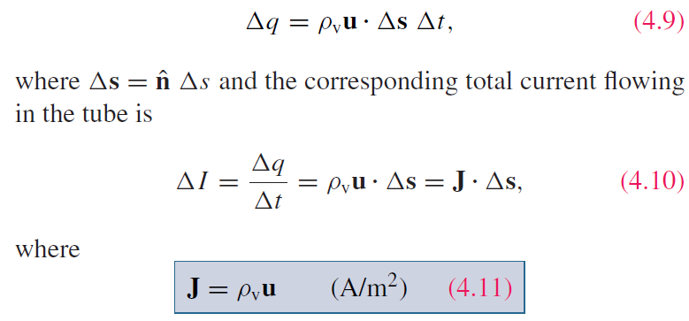
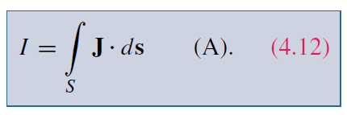
Current Density
For a surface with any orientation:
Charge velocity
J is the current density (A/m²)
I is the current (A)

Slide 7
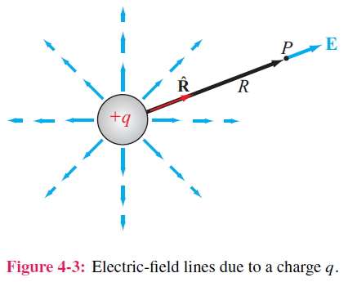
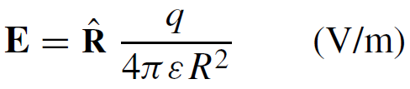
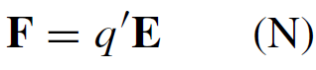
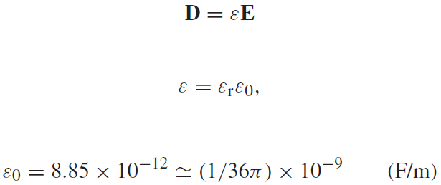
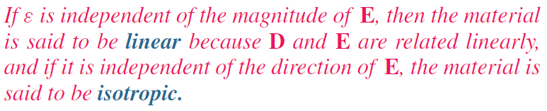
Coulomb’s Law
Electric field at point P due to single charge
Electric force on a test charge placed at P
Electric flux density D
vs. anisotropic

Slide 8
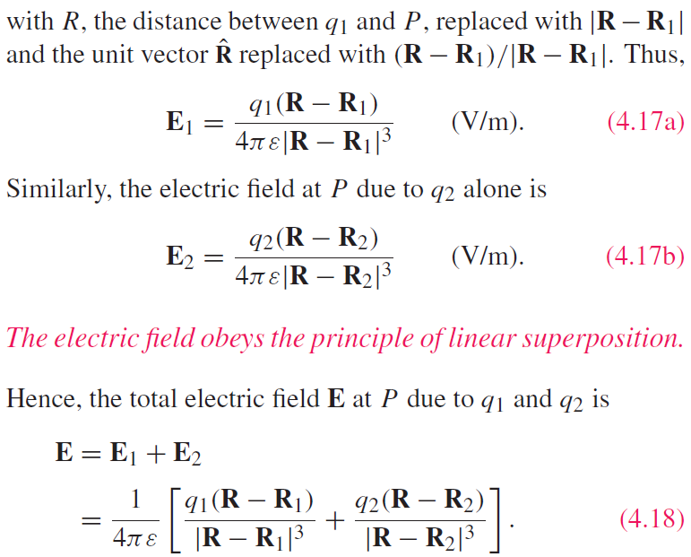
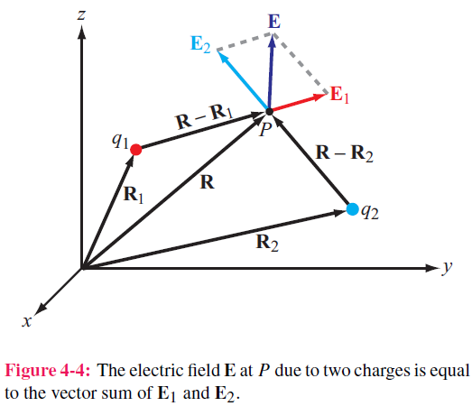
Electric Field Due to 2 Charges

Slide 9
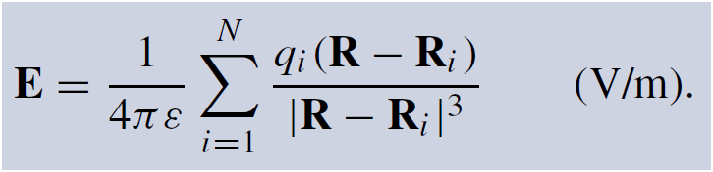
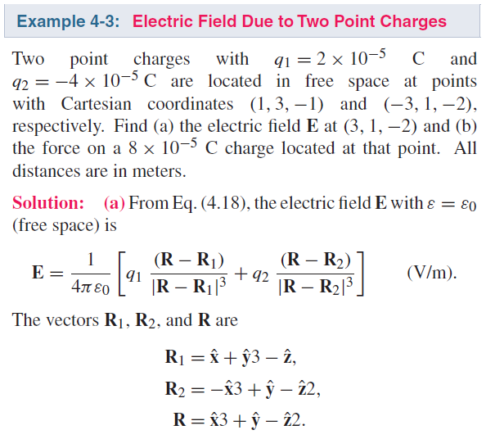
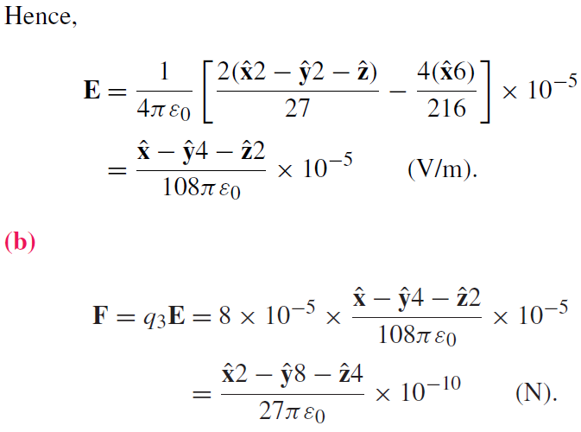
Electric Field due to Multiple Charges

Slide 10
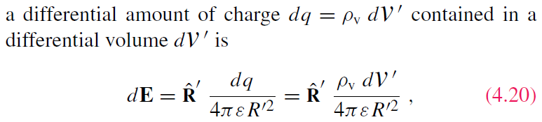
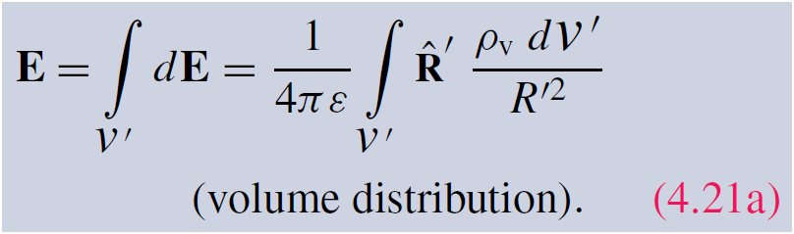
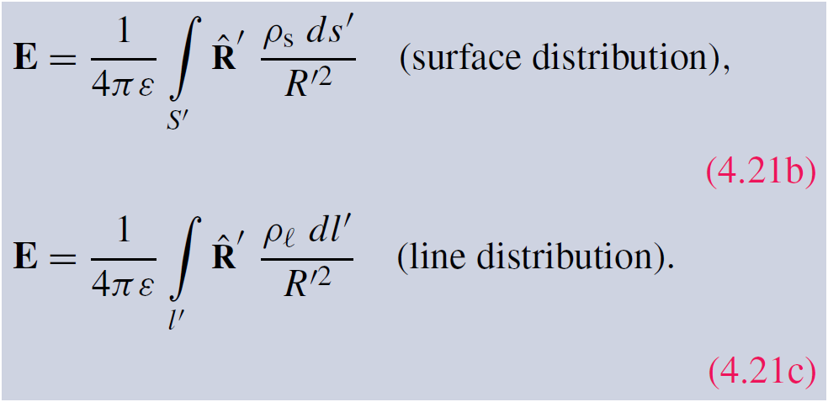
Electric Field Due to Charge Distributions
Field due to:

Slide 11
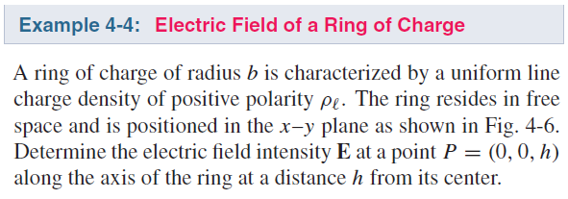
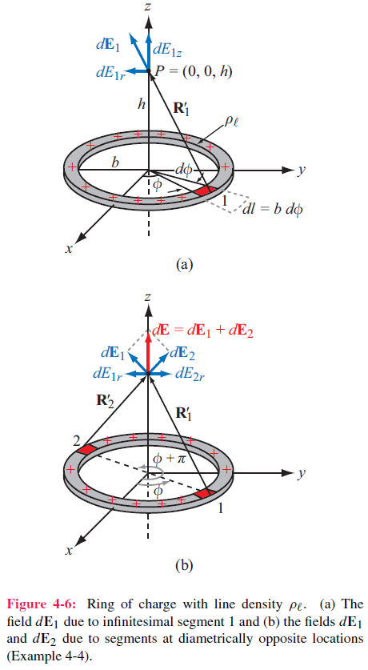
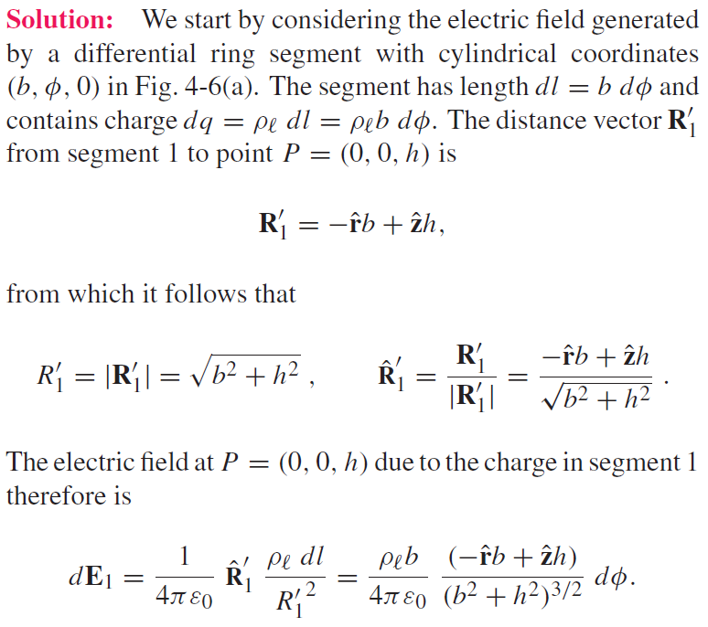
Cont.

Slide 12
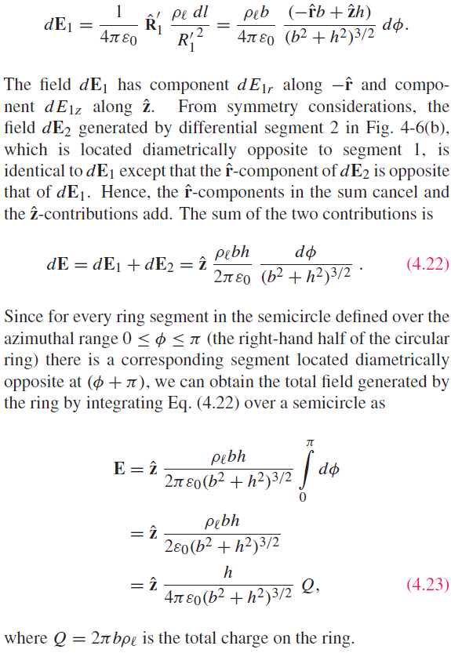

Slide 13
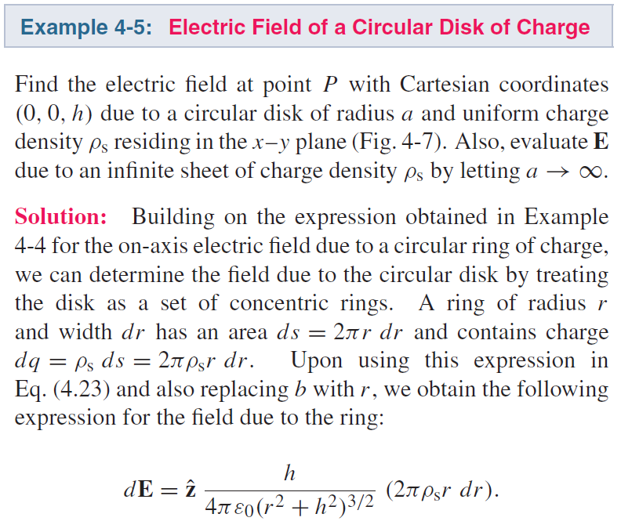
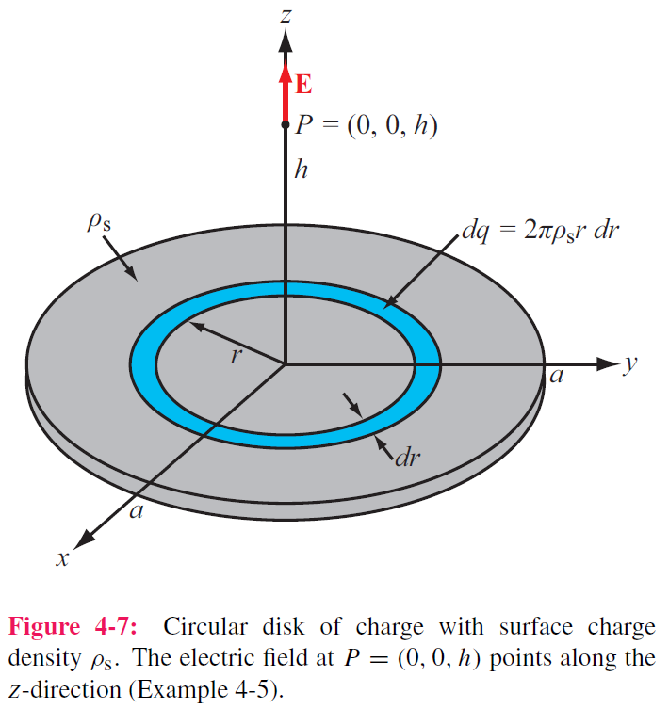
Cont.

Slide 14
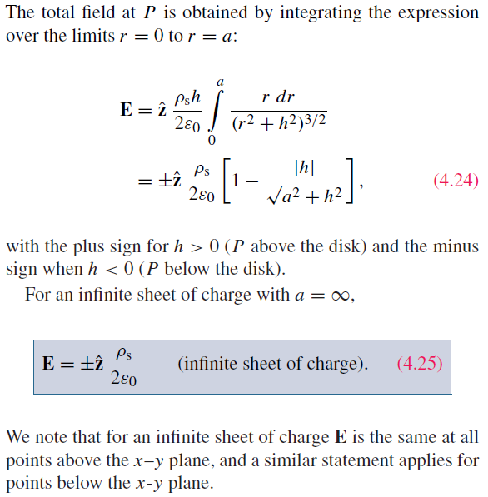

Slide 15
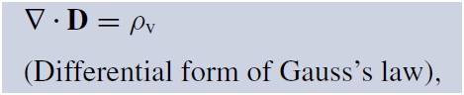
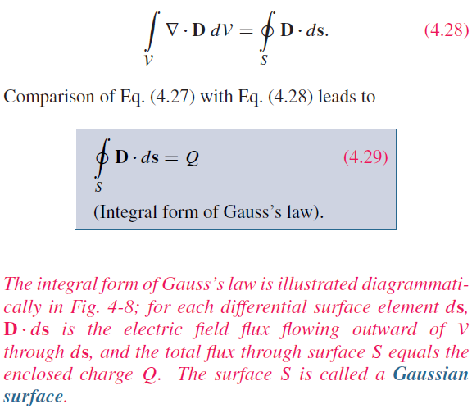
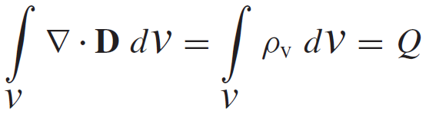
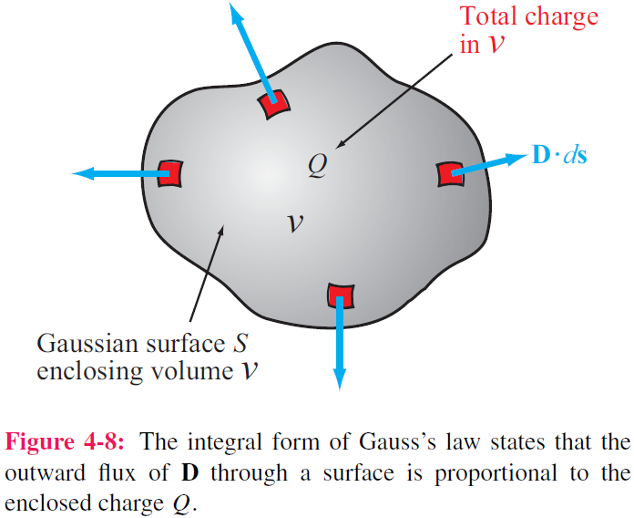
Gauss’s Law
Application of the divergence theorem gives:

Slide 16
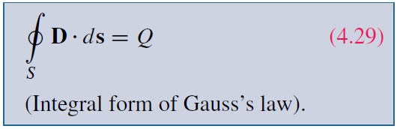
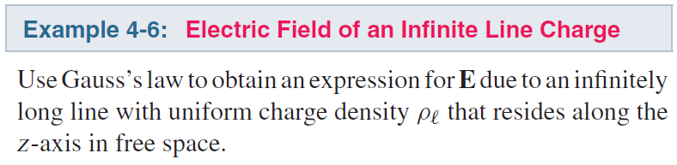
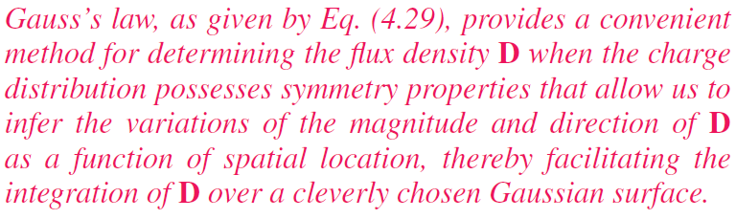
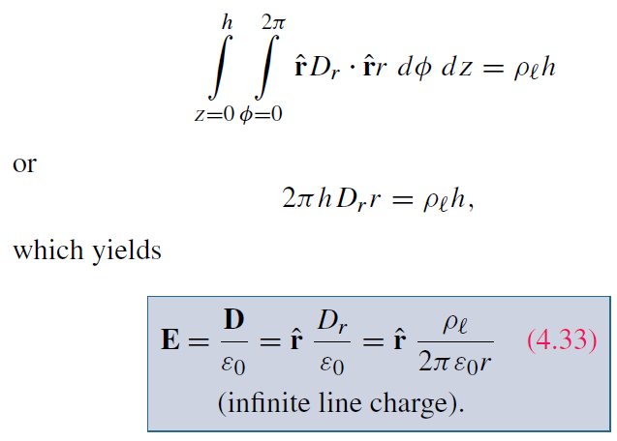
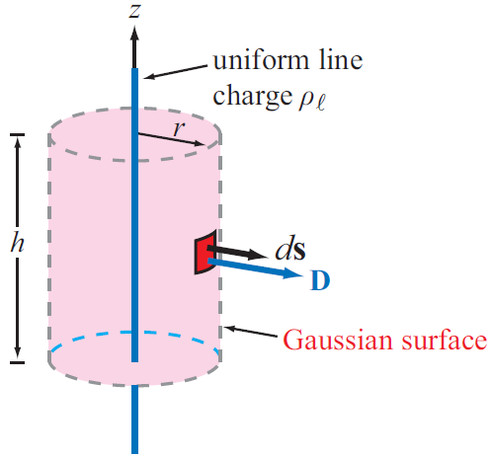
Applying Gauss’s Law
Construct an imaginary Gaussian cylinder of radius r and height h:
D is constant and normal or tangential to the surface
Textbook: If a point charge, selects a sphere surface!

Slide 17
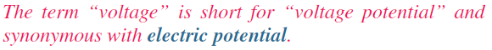
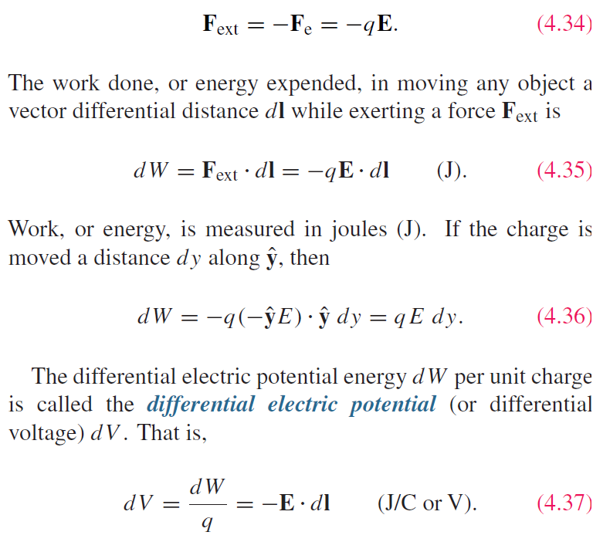
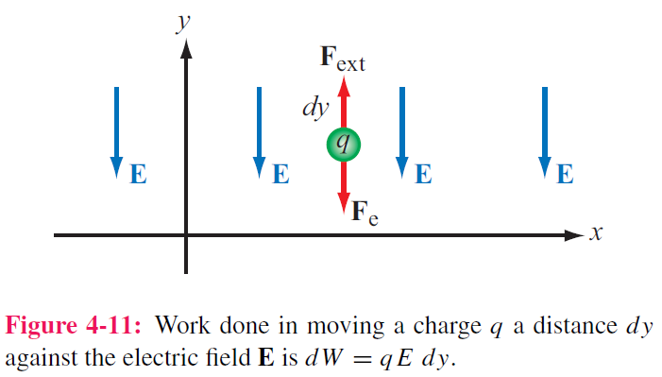
Electric Scalar Potential
Minimum force needed to move charge against E field:

Slide 18
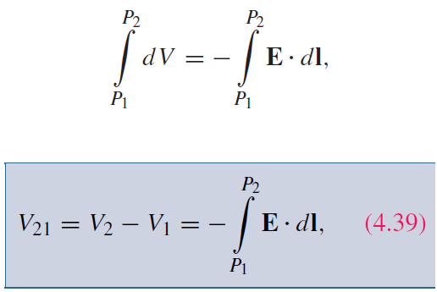
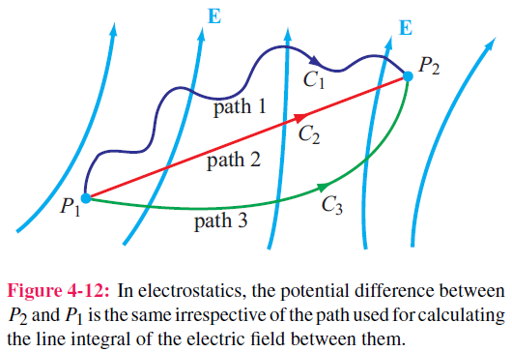
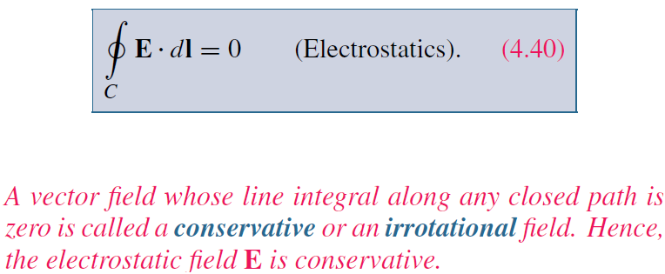
Electric Scalar Potential
The potential difference corresponding to moving a point charge from point P1 to point P2 is obtained by integrating Eq. (4.37) along any path between them

Slide 19
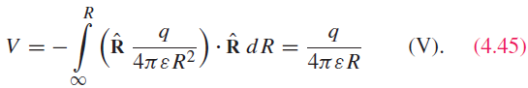
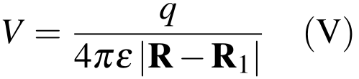



Electric Potential Due to Charges
For a point charge at origin, V at range R is:
If the point charge is at the position R₁,
In electric circuits, we usually select a convenient node that we call ground and assign it zero reference voltage. In free space and material media, we choose infinity as reference with V = 0. Hence, at a point P
For continuous charge distributions:

Slide 20


Relating E to V

Slide 21


Cont.

Slide 22



(cont.)

Slide 23


Poisson’s & Laplace’s Equations
In the absence of charges:

Slide 24
Conductor, Dielectrics, Capacitance

Slide 25




Conduction Current
Constitutive EM Parameters
Electric permittivity ε
Magnetic permeability μ
Conductivity σ
Homogeneous: the above parameters do not vary from point to point.
Isotropic: they are independent of direction.
Conduction current density:
Conductivity
Note how wide the range is, over 24 orders of magnitude

Slide 26

Conductivity
ρ_{ve} = volume charge density of electrons
ρ_{he} = volume charge density of holes
μ_{e} = electron mobility
μ_{h} = hole mobility
N_{e} = number of electrons per unit volume
N_{h} = number of holes per unit volume

Slide 27



Resistance
Longitudinal Resistor
For any conductor:

Slide 28



G’=0 if the insulating material is air or a perfect dielectric with zero conductivity.

Slide 29






Joule’s Law
The required energy for moving charge in an electric field over a differential distance is
The power dissipated in a volume containing electric field E and current density J is:
The corresponding power is
For a resistor,

Slide 30

Dielectrics
In nonpolar dielectric materials, electrons distributes symmetrically around the nulceus.
Electric field polarize the atoms
Polarized atoms form electric dipole.
The dipole moment is P=qd, directing to the positive charge
Polarized atoms produces internal E-field, named polarization field.

Slide 31

Dielectrics
The dipoles are aligned linearly with the external E-field E.
The net field present in the dielectric material is smaller than E, due to the polarization field.

Slide 32





Polarization field
In free space, the electric flux density
In presence of dipoles in a dielectric material,
With P being the electric polarization field.
In a linear medium, P is linearly proportional to E,
With X_{e} being the electric susceptibility.

Slide 33

Electric Breakdown
The dielectric material can sustain permanent damage due to electron collisions with the molecular structure, and ionization occurs.

Slide 34






Boundary Conditions (tan component)
$$∆h→0$$

Slide 35






Boundary Conditions (normal component)
$$∆h→0$$

Slide 36


Boundary Conditions
Tan component:
Normal component:

Slide 37





Slide 38

Summary of Boundary Conditions
Remember E = 0 in a good conductor

Slide 39


Dielectric-conductor surface
Net electric field inside a conductor is zero
Obtained from Gauss’ law or boundary condition

Slide 40

Field Lines at Conductor Boundary
At conductor boundary, E field direction is always perpendicular to conductor surface

Slide 43




Imperfect conductor-conductor surface
For tangential current, there is no transfer of charge between the two mediums
For normal current, the two currents has to be the same to maintain a constant charge density

Slide 44






Capacitance
The normal electric field at the surface of both conductors
The total charge number
The voltage between the two conductors

Slide 45


Capacitance
For any two-conductor configuration:
Generalized form
If the dielectric between the conductors is imperfect, current can flow with resistance

Slide 46




Slide 47



Application of Gauss’s law gives:
Q is total charge on the inside of outer cylinder, and –Q is on the outside surface of inner cylinder

Slide 48







Electrostatic Potential Energy in Capacitor
For a parallel-plate capacitor
Electrostatic potential energy density
Energy stored in a capacitor
Total electrostatic energy stored in a volume

Slide 49

Image Method for perfect conductor
Only valid for the region above conductor
Image method simplifies calculation for E and V due to charges near conducting planes.
For each charge Q, add an image charge –Q
Remove conducting plane
Calculate field due to all charges

Slide 50



Slide 51


Homework due XXX

